Slide 1
NAVIGATION SYSTEM FOR UBIT
University Of Karachi
Department Of Computer Science
Group Members:
Syed Osama Hussain
Taha Imtiaz
Syed Bilal Raees
Muneeb Ovais Khan
Course Supervisor: Dr. Humera Tariq

Slide 2
Required Content and Sequence
Introduction
Scenario/Problem Statement
Why It is important to Solve the Chosen Problem?
Sample Input
Sample Output
Filing / Database Design
Login Module
Admin Module
User Module
Module Wise UML Diagrams showing proper Relationship between classes
Attributes Handling
Private, static, protected, const
Code snippets of Constructor calling different types
Code Snippets of Copy/Clone
Shallow copy Concept
Deep Copy Concept
Code Snippets of Function Calling
Showing Object passing as parameter
Showing Object returns from function in class
Code Snippets of Overloading
Code Snippets of using arrays
Array of Objects
Polymorphic Array
<vector>, <list>
Code Snippets of Overriding
Code Snippets of Type Casting and Boxing-unBoxing
Learning and achievements
Improvement and Future Work
Demo and Queries

Slide 3
Bonus Features
Singleton Pattern for Object Creation
Composite Pattern for Module
MVC Pattern for Code Organization
Graphical user Interface (GUI)
Exceptions (Error Handling)
Generics / Templates

Slide 4
introduction
In this Section we described the chosen problem along with sample input and output.

Slide 5
Problem Statement
The objective of the project is to provide the shortest path to the students of UBIT from one room or node to the other, using Dijkstra algorithm. The department building consists of 3 floors and on each floor there are different types of rooms which include teachers’ room and special rooms also. Stairs are also taken into account because it takes more effort to cover them.
BSCS-415 Object Oriented Programming

Slide 6
Importance
It is important to solve the given problem because it can save a great deal of time of the students as well as of some newly appointed or visiting faculty teachers. They don’t have to run around searching for the class or room. It can improve the timing schedule of classes.

Slide 7
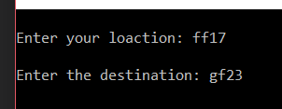

Sample Input
The user can enter the room number, teachers’ name or the purpose
of any special room in-order to search the shortest path.

Slide 8
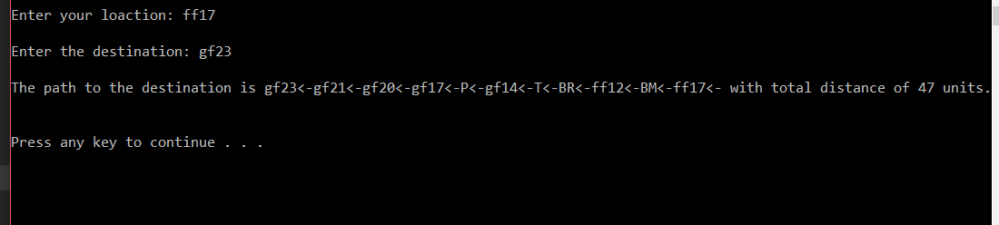
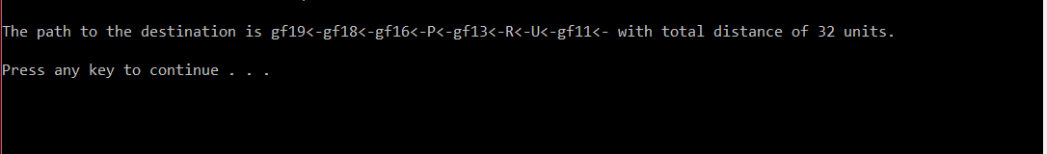
Sample Output
The output of the sample inputs is given below where random alphabets are the names of certain nodes.

Slide 9
Filing
Here we describe about Filing and information storage

Slide 10
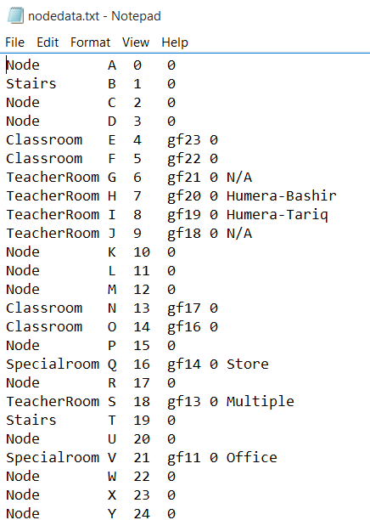
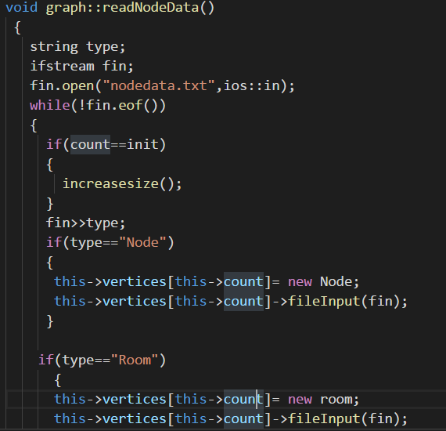
The data of nodes and its inherited classes is read from a text file with the following format by calling a fileInput function which takes istream object as argument.

Slide 11
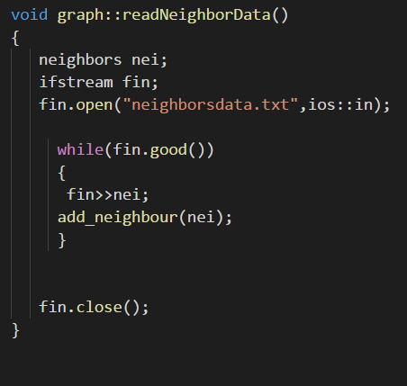
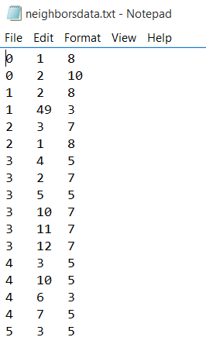
Similarly, neighbor objects are read from a separate text file for simplicity and overloaded operator is used for file reading.

Slide 12
UML Diagrams
In this section we describe Module Wise UML of important classes and UML of relationship between classes.

Slide 13
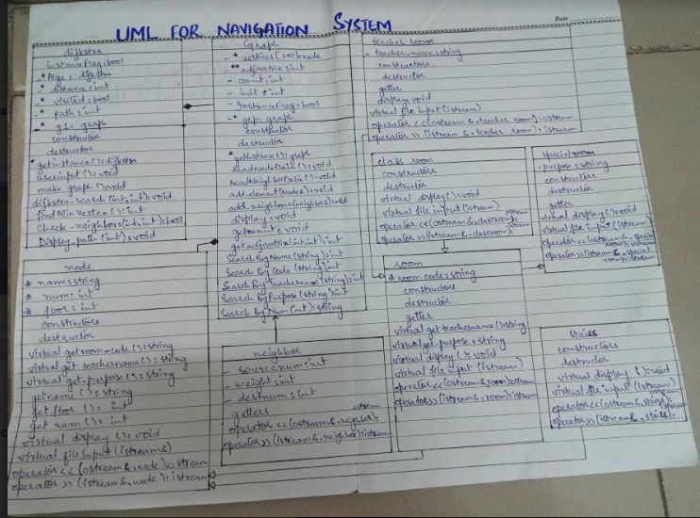
UML DIAGRAM FOR NAVIGATION SYSTEM OF UBIT

Slide 14
Attribute Handling
In this Section we described which attributes are kept private, which are kept static and which are kept final and Why we do so ??

Slide 15
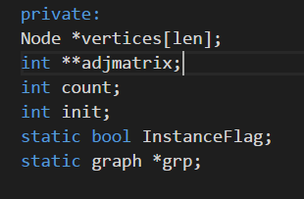

The attributes of the graph and algorithm classes are kept private due to data abstraction while there are two static attributes in-order to implement singleton pattern. Len is kept constant because array of pointers requires a constant value of pointers.

Slide 16
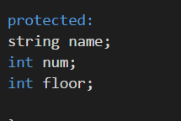

The attributes of node (on the left) and room (on the right) are kept protected because of their use in the inherited classes.

Slide 17
Constructor calling and function calling
In this section we described how we invoke functions to accomplish certain task. We also talked about parameter passing especially object passing as parameter and object returning from function.

Slide 18
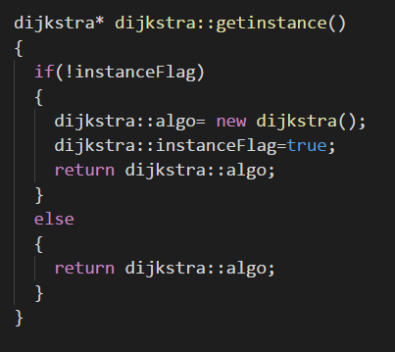
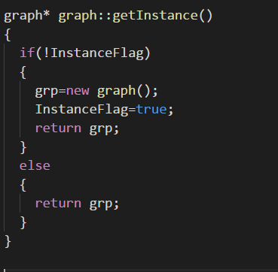
The constructors of Dijkstra and graph are called by using getinstance function because they are kept private while the inherited constructors are discussed in the inheritance section.

Slide 19
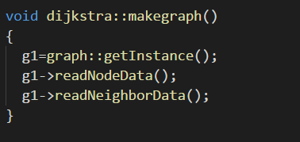

This slide shows the method to call functions on a dynamic object and passing an object to a function.

Slide 20
Overloading
In this Section we demonstrate operator overloading.

Slide 21
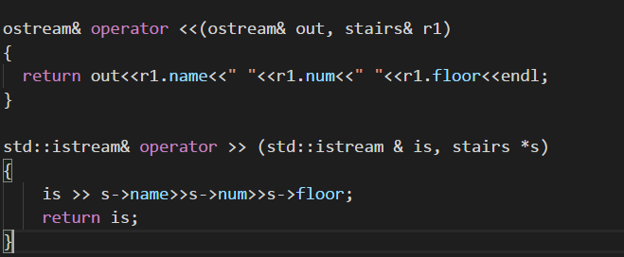

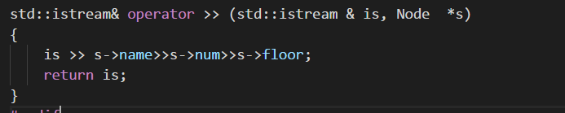
This slide demonstrates use of operator overloading and definition of such functions.

Slide 22
Array of objects
Here we describes the grouping of similar objects via arrays, list and other containers

Slide 23
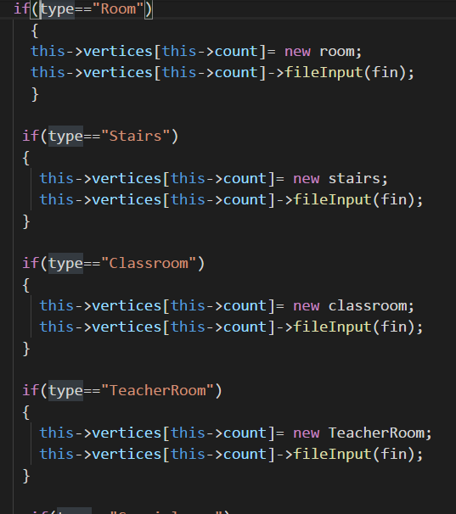
An array of pointers is used of node type which is also a polymorphic array in-order to store vertices of the graph.

Slide 24
Inheritance and polymorphism
Here we describe about Inheritance, Polymorphism, Polymorphic Array and Overriding.

Slide 25
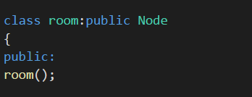
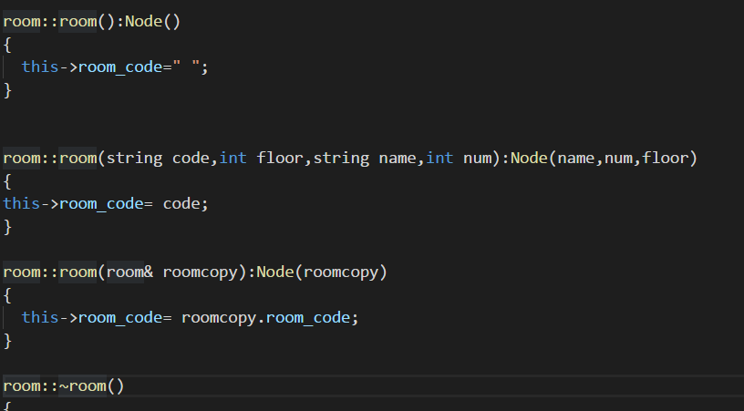
The constructors are used in the following way in inheritance. The base constructors are called from the derived constructors. The program consists of a two level inheritance hierarchy. Node is inherited into stairs and room while room has 3 derived classes.

Slide 26
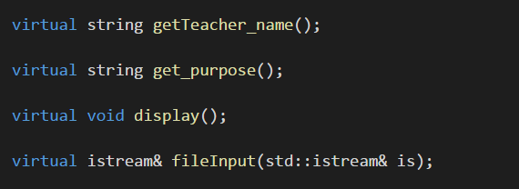
Vertices is a polymorphic array of node type which calls the fileInput function according to the derived objects at that particular index, executing run time polymorphism. The two getter functions and display are overrided in derived classes.

Slide 27
Mathematics, logic , data structure and ai
Here we describe about Mathematics and Logics from Discrete Mathematics domain. It may talk about Algorithms, Matrices, Data Structure, Graph, Tree, Number Theory …………………..

Slide 28
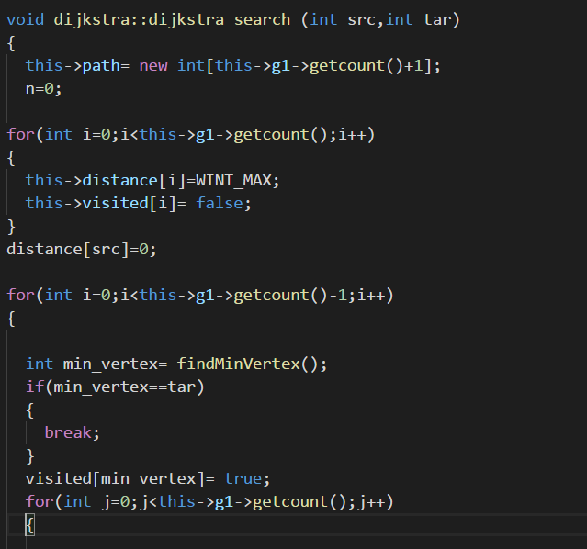
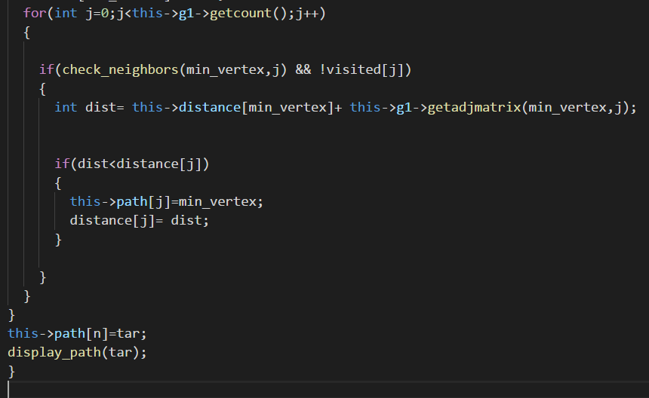
Following is the slightly modified implementation of the Dijkstra algorithm, which is a popular algorithm for finding the shortest path in a given graph.

Slide 29
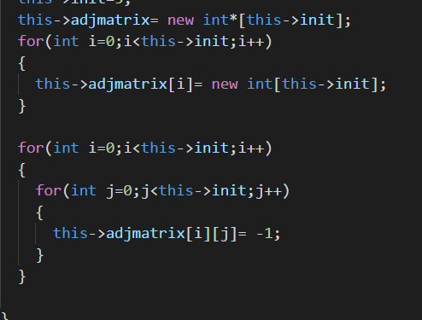
We have implemented the graph data structure by using the adjacency matrix representation for a weighted undirected graph.

Slide 30
Any other content you want to highlight from your project
In this section we describe Our Module / Programming effort which we did as a part of project requirement.

Slide 31


We have used singleton pattern for creation of graph and Dijkstra objects according to our requirement.

Slide 32
Learning and Achievements
In this section we describe the things that makes us feel that we have learned, we did something new , we did something that is different and thus we should get full marks or even we deserves Bonus marks.

Slide 33
We have studied and implemented the graph data structure and Dijkstra algorithm which would have been taught to us in future semesters. In addition to this we also built a GUI representing our program. We worked on practical data gathered by us and have done sincere effort on mapping the department on a graph and used a big amount of data.

Slide 34
Improvements and future work
In this section we mention the tasks that are still unresolved. The exceptional cases where still improvement is needed. We also mention the applications that can build on top of our current work.

Slide 35
Some improvements are still needed in the program such as taking into account a more efficient algorithm and extracting data from a google maps API which is more precise and can save time of typing data into text files. In future this program can be used on a bigger scale and a mobile application can be made to provide easier access to the students and employees of our university and save a great deal of time.

Slide 36
Demo and Queries
What improvements do you suggest in our program?
Can a mobile application be made using c++ or we have to study other options?
Is their any other efficient way to read more precise data for our program?

